Slide 1
Data Structures and Algorithms (12)
(CS F211)

Slide 2

Hashing &
Udi Manber says that the three most important algorithms at Yahoo are
  hashing
  hashing
  hashing.
Hashing has a variety of clever applications beyond just speeding up search, by giving you a short but distinctive representation of a larger document.
Is this new document different from the rest in a large corpus? – Hash the new document, and compare it to the hash codes of corpus.
How can I convince you that a file isn’t changed? – Check if the cryptographic hash code of the file you give me today is the same as that of the original. Any changes to the file will change the hash code.

Slide 3
Hash Tables
All search structures so far
  Relied on a comparison operation
  Performance O(n) or O( log n)
Assume I have a function
  f ( key ) → integer
  ie one that maps a key to an integer
What performance might I expect now?

Slide 4
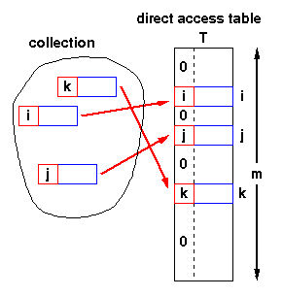
Hash Tables - Structure
Simplest case:
  Assume items have integer keys in the range 1 .. m
  Use the value of the key itself
  to select a slot in a
  direct access table
  in which to store the item
  To search for an item with key, k,
  just look in slot k
    If there’s an item there,
    you’ve found it
    If the tag is 0, it’s missing.
  Constant time, O(1)

Slide 5
Hash Tables - Constraints
Constraints
  Keys must be unique
  Keys must lie in a small range
  For storage efficiency,
  keys must be dense in the range
  If they’re sparse (lots of gaps between values),
  a lot of space is used to obtain speed
    Space for speed trade-off

Slide 6
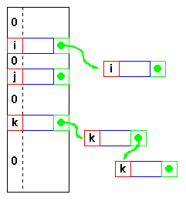
Hash Tables - Relaxing the constraints
Keys must be unique
  Construct a linked list of duplicates
  “attached” to each slot
  If a search can be satisfied
  by any item with key, k,
  performance is still O(1)
  but
  If the item has some
  other distinguishing feature
  which must be matched,
  we get O(n_{max})
  where n_{max} is the largest number
  of duplicates - or length of the longest chain

Slide 7
Hash Tables - Relaxing the constraints
Keys are integers
  Need a hash function
  h( key ) → integer
  ie one that maps a key to
  an integer
  Applying this function to the
  key produces an address
  If h maps each key to a unique
  integer in the range 0 .. m-1
  then search is O(1)

Slide 8
Hash Functions
Two parts:
  Convert key into an integer in case the key is not an integer.
    Done by the method hashCode().
  Map an integer into a home bucket.
    f(k) is an integer in the range [0, m-1], where m is the number of buckets in the table.
A hash function is usually specified as the composition of two functions:
Hash code h₁: keys → integers
Compression function h₂: integers → [0, N - 1]
The hash code is applied first, and the compression function is applied next on the result, i.e.,
h(x) = h₂(h₁(x))
The goal of the hash function is to “disperse” the keys in a random way
Notes:
Object.hashCode() returns an int based on the reference value of this. So user defined classes must over ride Object.hashCode() for things to work right.
hashCode() is already defined properly for Java’s classes: Integer, Long, Float, Double, String, Character, etc. The hashCode() definition in these classes over rides the default definition in Object. Note that hashCode may return a negative int.

Slide 9
Hash Tables - Hash functions
Form of the hash function
  Example - using an n-character key
  int hash(char *s, int n ) {
  int sum = 0;
  while( n-- ) sum = sum + *s++; // hashCode
  return sum % 256; // Compression Function
  }
  returns a value in 0 .. 255
  xor function is also commonly used
  sum = sum ^ *s++;
  But any function that generates integers in 0..m-1 for some suitable (not too large) m will do
  As long as the hash function itself is O(1) !

Slide 10

Hash Tables - Collisions
Hash function
  With this hash function
  int hash( char *s, int n ) {
  int sum = 0;
  while( n-- ) sum = sum + *s++;
  return sum % 256;
  }
  hash( “AB”, 2 ) and
  hash( “BA”, 2 )
  return the same value!
  This is called a collision
  A variety of techniques are used for resolving collisions

Slide 11
Hash Tables - Collision handling
Collisions
  Occur when the hash function maps
  two different keys to the same address
  The table must be able to recognise and resolve this
  Recognise
    Store the actual key with the item in the hash table
    Compute the address
      k = h( key )
    Check for a hit
      if ( table[k].key == key ) then hit
      else try next entry
  Resolution
    Variety of techniques
We’ll look at various
“try next entry” schemes

Slide 12
Methods of Resolution
Chaining:
  Store all elements that hash to the same slot in a linked list.
  Store a pointer to the head of the linked list in the hash table slot.
Open Addressing:
  All elements stored in hash table itself.
  When collisions occur, use a systematic (consistent) procedure to store elements in free slots of the table.
0
k₁
k₄
k₅
k₂
k₆
k₇
k₃
k₈
m–1

Slide 13
Collision Resolution by Chaining
0
U
(universe of keys)
h(k₁)=h(k₄)
X
k₁
k₄
K
(actual
keys)
k₂
k₆
X
h(k₂)=h(k₅)=h(k₆)
k₅
k₈
k₇
k₃
X
h(k₃)=h(k₇)
h(k₈)
m–1

Slide 14
Collision Resolution by Chaining
0
U
(universe of keys)
k₁
k₄
k₁
k₄
K
(actual
keys)
k₂
k₆
k₅
k₂
k₆
k₅
k₈
k₇
k₃
k₇
k₃
k₈
m–1

Slide 15
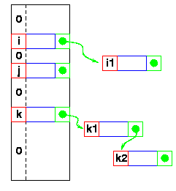
Hash Tables - Linked lists
Collisions - Resolution
  Linked list attached
  to each primary table slot
    h(i) == h(i1)
    h(k) == h(k1) == h(k2)
  Searching for i1
    Calculate h(i1)
    Item in table, i,
    doesn’t match
    Follow linked list to i1
  If NULL found,
  key isn’t in table
Theorem:
A successful search takes expected time Θ(1+α).
Load factor α=n/m = average keys per slot.
  m – number of slots.
  n – number of elements stored in the hash table.

Slide 16
Hashing with Chaining
Dictionary Operations:
Chained-Hash-Insert (T, x)
  Insert x at the head of list T[h(key[x])].
  Worst-case complexity – O(1).
Chained-Hash-Delete (T, x)
  Delete x from the list T[h(key[x])].
  Worst-case complexity – proportional to length of list with singly-linked lists. O(1) with doubly-linked lists.
Chained-Hash-Search (T, k)
  Search an element with key k in list T[h(k)].
  Worst-case complexity – proportional to length of list.

Slide 17
Analysis on Chained-Hash-Search
Load factor α=n/m = average keys per slot.
  m – number of slots.
  n – number of elements stored in the hash table.
Worst-case complexity: Θ(n) + time to compute h(k).
Average depends on how h distributes keys among m slots.
Assume
  Simple uniform hashing.
    Any key is equally likely to hash into any of the m slots, independent of where any other key hashes to.
  O(1) time to compute h(k).
Time to search for an element with key k is Θ(|T[h(k)]|).
Expected length of a linked list = load factor = α = n/m.

Slide 18
Expected Cost of an Unsuccessful Search
Theorem:
An unsuccessful search takes expected time Θ(1+α).
Proof:
Any key not already in the table is equally likely to hash to any of the m slots.
To search unsuccessfully for any key k, need to search to the end of the list T[h(k)], whose expected length is α.
Adding the time to compute the hash function, the total time required is Θ(1+α).

Slide 19
Expected Cost of a Successful Search
Theorem:
A successful search takes expected time Θ(1+α).
Proof:
The probability that a list is searched is proportional to the number of elements it contains.
Assume that the element being searched for is equally likely to be any of the n elements in the table.
The number of elements examined during a successful search for an element x is 1 more than the number of elements that appear before x in x’s list.
  These are the elements inserted after x was inserted.
Goal:
  Find the average, over the n elements x in the table, of how many elements were inserted into x’s list after x was inserted.

Slide 20
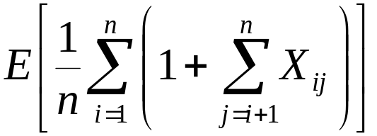
Expected Cost of a Successful Search
Theorem:
A successful search takes expected time Θ(1+α).
Proof (contd):
Let x_{i} be the i^{th} element inserted into the table, and let k_{i} = key[x_{i}].
Define indicator random variables X_{ij} = I{h(k_{i}) = h(k_{j})}, for all i, j.
Simple uniform hashing ⇒ Pr{h(k_{i}) = h(k_{j})} = 1/m
⇒ E[X_{ij}] = 1/m.
Expected number of elements examined in a successful search is:
No. of elements inserted after x_{i} into the same slot as x_{i}.

Slide 21
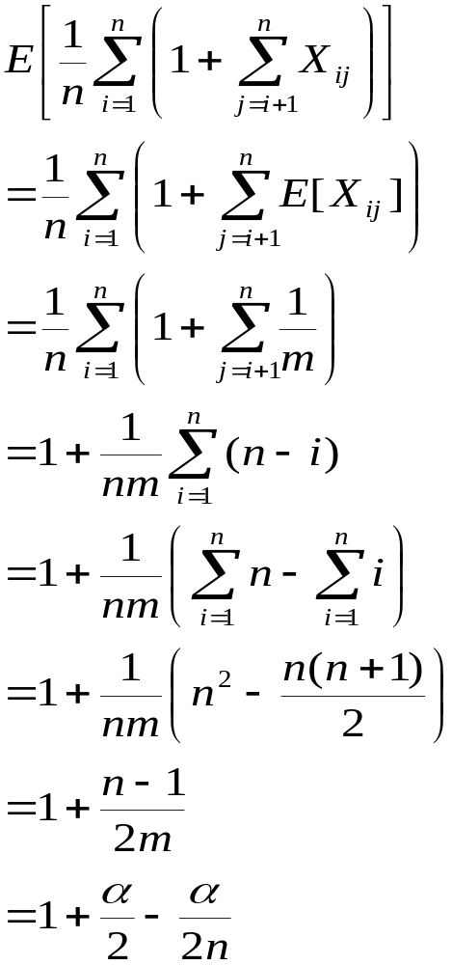
Proof – Contd.
(linearity of expectation)
Expected total time for a successful search = Time to compute hash function + Time to search
= O(2+α/2 – α/2n) = O(1+ α).

Slide 22
Expected Cost – Interpretation
If n = O(m), then α=n/m = O(m)/m = O(1).
⇒ Searching takes constant time on average.
Insertion is O(1) in the worst case.
Deletion takes O(1) worst-case time when lists are doubly linked.
Hence, all dictionary operations take O(1) time on average with hash tables with chaining.

Slide 23
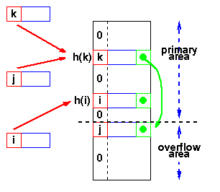
Hash Tables - Overflow area
  Overflow area
    Linked list constructed
    in special area of table
    called overflow area
  h(k) == h(j)
  k stored first
  Adding j
    Calculate h(j)
    Find k
    Get first slot in overflow area
    Put j in it
    k’s pointer points to this slot
  Searching - same as linked list

Slide 24
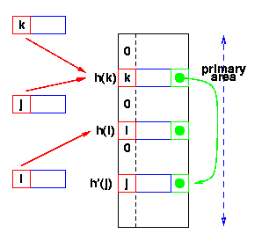
Hash Tables - Re-hashing
  Use a second hash function
    Many variations
    General term: re-hashing
  h(k) == h(j)
  k stored first
  Adding j
    Calculate h(j)
    Find k
    Repeat until we find an empty slot
      Calculate h’(j)
    Put j in it
  Searching - Use h(x), then h’(x)
h’(x) -
second hash function

Slide 25
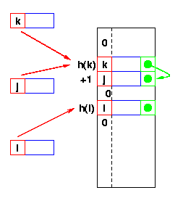
Hash Tables - Re-hash functions
  The re-hash function
    Many variations
  Linear probing
    h’(x) is +1
    Go to the next slot
    until you find one empty
  Can lead to bad clustering
  Re-hash keys fill in gaps
  between other keys and exacerbate
  the collision problem

Slide 26
Linear Probing – Get And Put
divisor = b (number of buckets) = 17.
Home bucket = key % 17.
0
4
8
12
16
34
0
45
6
23
7
28
12
29
11
30
33
Put in pairs whose keys are 6, 12, 34, 29, 28, 11, 23, 7, 0, 33, 30, 45

Slide 27
Linear Probing – Remove
0
4
8
12
16
34
0
45
6
23
7
28
12
29
11
30
33
remove(0)
0
4
8
12
16
34
45
6
23
7
28
12
29
11
30
33
Search cluster for pair (if any) to fill vacated bucket.
0
4
8
12
16
34
45
6
23
7
28
12
29
11
30
33

Slide 28
Linear Probing – remove(34)
0
4
8
12
16
34
0
45
6
23
7
28
12
29
11
30
33
0
4
8
12
16
0
45
6
23
7
28
12
29
11
30
33
Search cluster for pair (if any) to fill vacated bucket.
0
4
8
12
16
0
45
6
23
7
28
12
29
11
30
33
0
4
8
12
16
0
45
6
23
7
28
12
29
11
30
33

Slide 29
Linear Probing – remove(29)
0
4
8
12
16
34
0
45
6
23
7
28
12
29
11
30
33
0
4
8
12
16
34
0
45
6
23
7
28
12
11
30
33
Search cluster for pair (if any) to fill vacated bucket.
0
4
8
12
16
34
0
45
6
23
7
28
12
11
30
33
0
4
8
12
16
34
0
45
6
23
7
28
12
11
30
33
0
4
8
12
16
34
0
6
23
7
28
12
11
30
45
33

Slide 30
Hash Tables - Re-hash functions
  The re-hash function
    Many variations
  Quadratic probing
    h’(x) is c i² on the i^{th} probe
    Avoids primary clustering
    Secondary clustering occurs
      All keys which collide on h(x) follow the same sequence
      First
        a = h(j) = h(k)
      Then a + c, a + 4c, a + 9c, ....
      Secondary clustering generally less of a problem
Theorem:
The expected number of probes in an unsuccessful search in an open-
address hash table is at most 1/(1–α).

Slide 31
Hash Tables - Summary so far ...
Potential O(1) search time
  If a suitable function h(key) → integer can be found
Space for speed trade-off
  “Full” hash tables don’t work (more later!)
Collisions
  Inevitable
    Hash function reduces amount of information in key
  Various resolution strategies
    Linked lists
    Overflow areas
    Re-hash functions
      Linear probing h’ is +1
      Quadratic probing h’ is +ci²
      Any other hash function!
        or even sequence of functions!

Slide 32
Hash Tables - Choosing the Hash Function
“Almost any function will do”
  But some functions are definitely better than others!
Key criterion
  Minimum number of collisions
    Keeps chains short
    Maintains O(1) average

Slide 33
Hash Tables - Choosing the Hash Function
Uniform hashing
  Ideal hash function
    P(k) = probability that a key, k, occurs
    If there are m slots in our hash table,
    a uniform hashing function, h(k), would ensure:
    or, in plain English,
    the number of keys that map to each slot is equal
Σ P(k) =
Σ P(k) = ....
Σ P(k) =
1
m
k | h(k) = 0
k | h(k) = 1
k | h(k) = m-1
Read as sum over all k such that h(k) = 0

Slide 34
Hash Tables - A Uniform Hash Function
If the keys are integers
randomly distributed in [ 0 , r ),
then
is a uniform hash function
Most hashing functions can be made to map the keys
to [ 0 , r ) for some r
  eg adding the ASCII codes for characters mod 255
  will give values in [ 0, 256 ) or [ 0, 255 ]
  Replace + by xor
    same range without the mod operation
Read as 0 ≤ k < r
mk
h(k) =
r

Slide 35
Hash Tables - Reducing the range to [ 0, m )
We’ve mapped the keys to a range of integers
0 ≤ k < r
Now we must reduce this range to [ 0, m )
where m is a reasonable size for the hash table
Strategies
  Division - use a mod function
  Multiplication
  Universal hashing

Slide 36
Hash Tables - Reducing the range to [ 0, m )
Division
  Use a mod function
    h(k) = k mod m
  Choice of m?
    Powers of 2 are generally not good!
    Prime numbers close to 2^{n} seem to be good choices
    eg want ~4000 entry table, choose m = 4093

Slide 37
Hash Tables - Reducing the range to [ 0, m )
Multiplication method
  Multiply the key by constant, A, 0 < A < 1
  Extract the fractional part of the product
    ( kA - ⎣kA⎦ )
  Multiply this by m
    h(k) = ⎣m * ( kA - ⎣kA⎦ )⎦
  Now m is not critical and a power of 2 can be chosen
  So this procedure is fast on a typical digital computer
    Set m = 2^{p}
    Multiply k (w bits) by ⎣A•2^{w}⎦ ⬅ 2w bit product
    Extract p most significant bits of lower half
    A = ½(√5 -1) seems to be a good choice (see Knuth)

Slide 38
Hash Tables - Load factor
Collisions are very probable!
Table load factor
must be kept low
Detailed analyses of the average chain length
(or number of comparisons/search) are available
Separate chaining
  linked lists attached to each slot
gives best performance
  but uses more space!
n
n = number of items
α =
m
m = number of slots

Slide 39
Hash Tables - General Design
Choose the table size
  Large tables reduce the probability of collisions!
  Table size, m
  n items
  Collision probability α = n / m
Choose a table organisation
  Does the collection keep growing?
    Linked lists (....... but consider a tree!)
  Size relatively static?
    Overflow area or
    Re-hash
Choose a hash function
....

Slide 40
Hash Tables - General Design
Choose a hash function
  A simple (and fast) one may well be fine ...
  Read your text for some ideas!
Check the hash function against your data
  Fixed data
    Try various h, m
    until the maximum collision chain is acceptable
    Known performance
  Changing data
    Choose some representative data
    Try various h, m until collision chain is OK
    Usually predictable performance

Slide 41
Hash Tables - Review
If you can meet the constraints
Hash Tables will generally give good performance
O(1) search
  Like radix sort,
  they rely on calculating an address from a key
  But, unlike radix sort,
  relatively easy to get good performance
    with a little experimentation
      not advisable for unknown data
    collection size relatively static
    memory management is actually simpler
      All memory is pre-allocated!

Slide 42
Linear Probing
h(k, i) = (h′(k)+i) mod m.
key
Probe number
Auxiliary hash function

Slide 43
Quadratic Probing
h(k,i) = (h′(k) + c₁i + c₂i²) mod m c₁≠ c₂
key
Probe number
Auxiliary hash function

Slide 44
Double Hashing
h(k,i) = (h₁(k) + i h₂(k)) mod m
key
Probe number
Auxiliary hash functions

